Slide 1
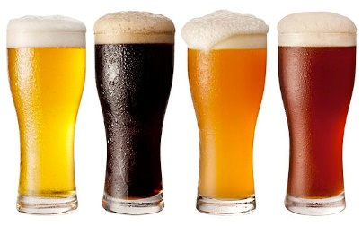
This Photo by Unknown Author is licensed under CC BY-SA
Unit 8 Project
EDA By: Hao Wang and Alex Salamah
October 2019

Slide 2

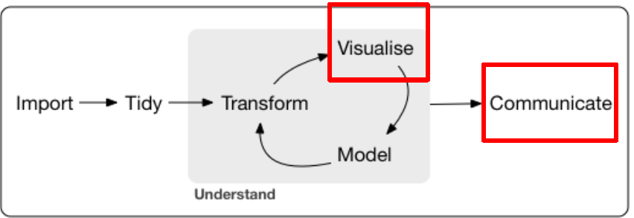
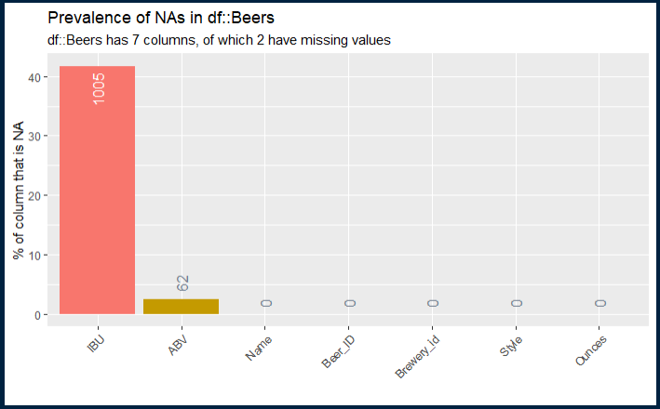
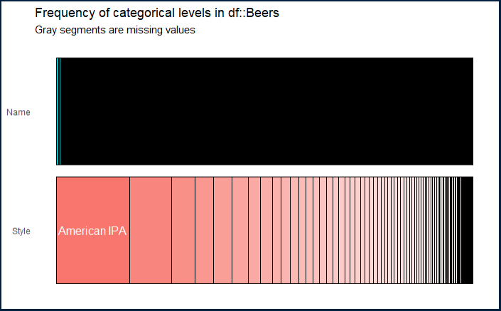
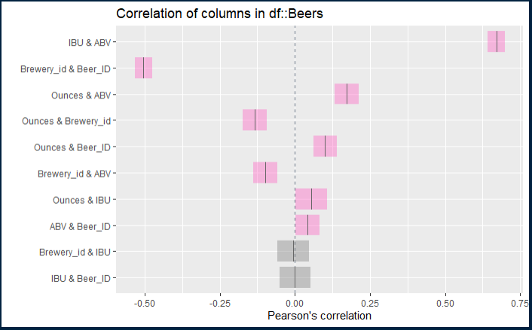
INITIAL DATA PROFILING BEERS DATA SET
Beers data set: 2410 observations, 7 variables.
2 factors: Name & Style
3 integers: Beer ID, IBU & Brewery ID
2 numeric: ABV & Ounces
Missing Values:
IBU: 1005 observations (42%)
ABV: 62 observations (3%)
Unique Values:
Beer Name: 2305 unique values and 105 duplicates.
Beer Style: 100 unique values
Categories: The most prevalent category in the style dimension is “American IPA” (Fig. 2)
Figure 1 Missing Values Analysis
Figure 2 Categorical Analysis
Figure 3 Coloration Analysis
Notes:
Substantial number of observation is missing from the IBU attribute 1005 almost 42%
Initial correlation analysis indicate between IBU and ABV also between Ounces and ABV.

Slide 3

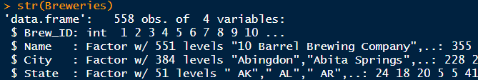
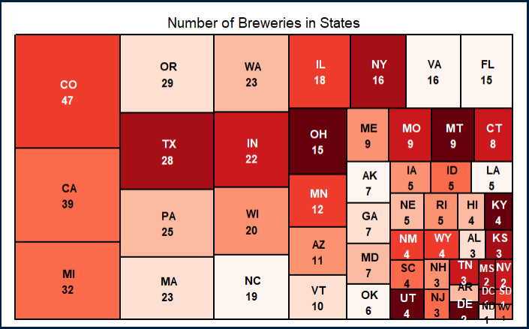
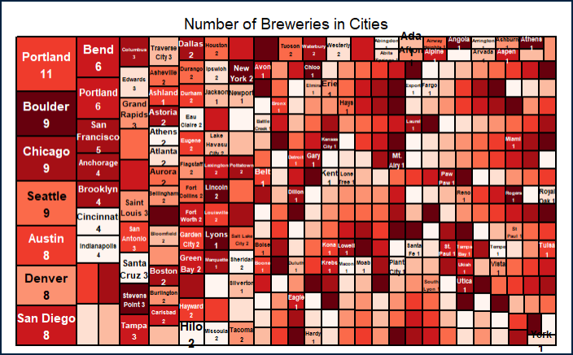
INITIAL DATA PROFILING BREWERIES DATA SET
The raw Breweries data set consists of 558 observations and four variables (Fig. 1):
Three Factors: Name, City & State
One Integer: Brewery ID
Missing Values: None
Unique Values: The Breweries are all uniquely identified and are spread out across 384 cities in 51 states. Colorado has the largest number of breweries (47) Followed by California (39) and Michigan (32) in 3rd place. (Fig. 2)
Portland leads the cities with 11 Breweries
Figure 1Brewries Data Set Profile
Figure 2 Breweries Count By State
Figure 3 Breweries Count By City
Notes:
Question 1

Slide 4
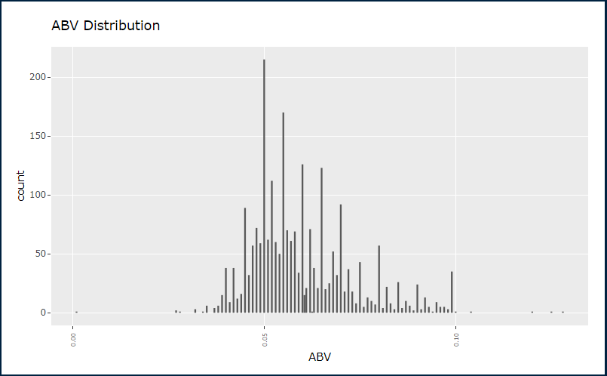
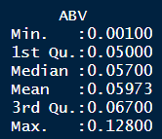
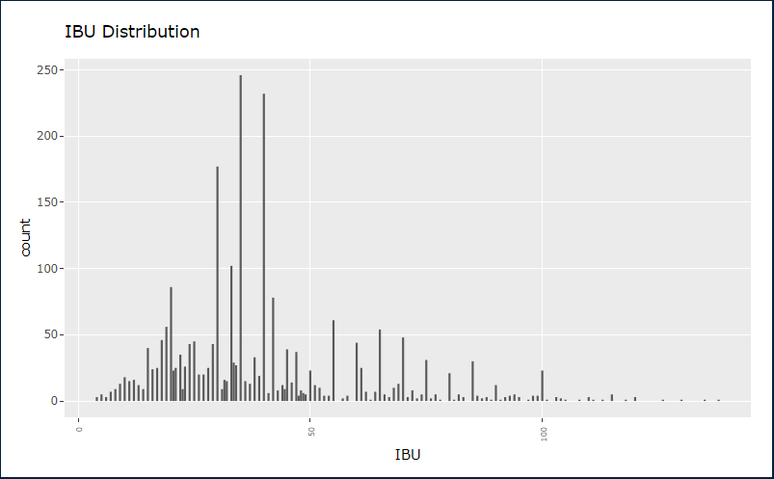
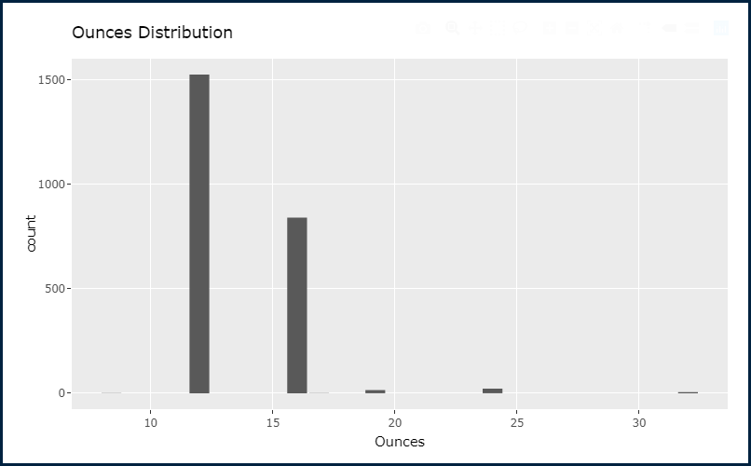
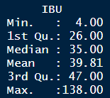
EDA – ABV & IBU distribution Merged Breweries and Beers DF
The Alcohol By Volume (ABV) distribution appears to be normal with a mean at 0.059 and a median at 0.057. (Fig. 1)
The International Bitterness Units (IBU) is also relatively normally distributed with a median of 35 and a mean of 39.81. (Fig 2)
Both variables appear to have some outliers
Figure 1 ABV distribution post cleanup
Figure 2 IBU Distribution post Cleanup
Figure 3 Can size distribution
Notes:
After removing missing values

Slide 5
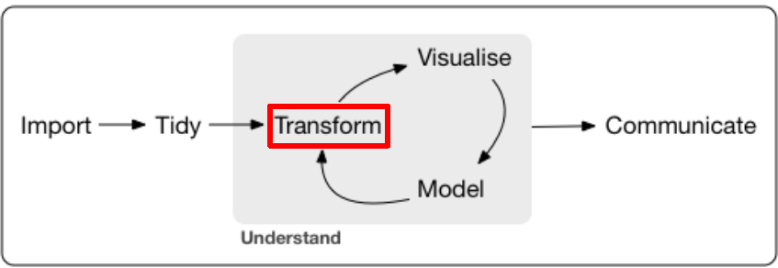
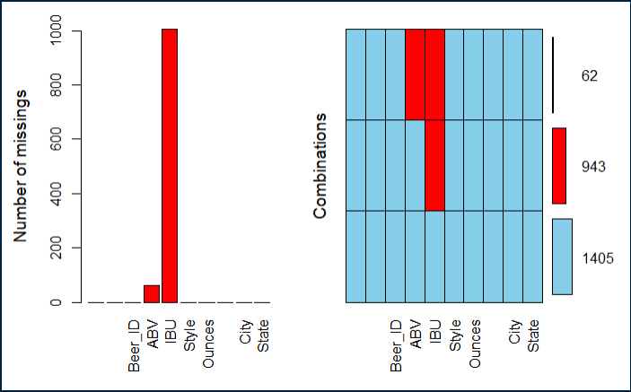
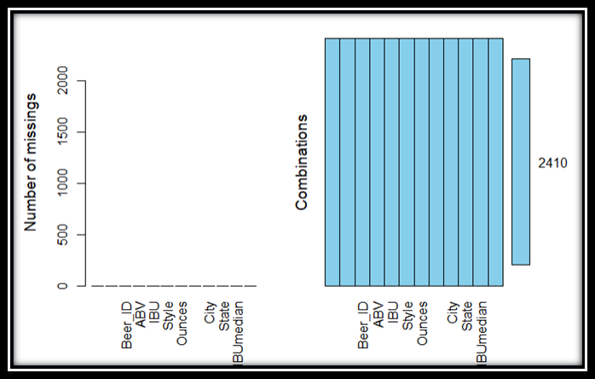
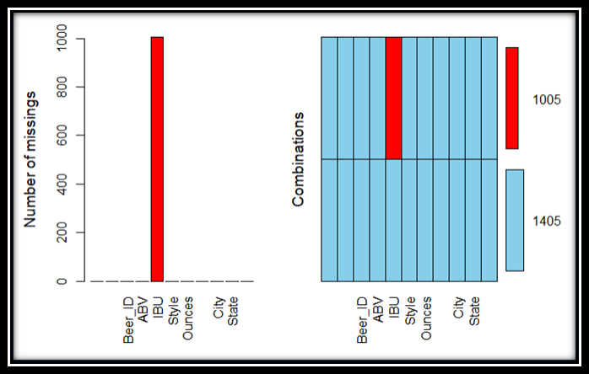
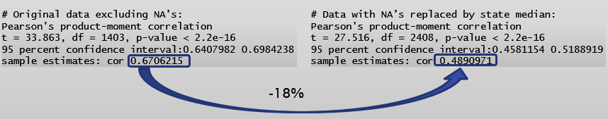
DATA Transformation MISSING VALUES IN MERGED DF
Identifying Missing values:
There 62 observations where both ABV and IBU are NA’s
943 observations where the IBU only are NA’s (Fig. 1)
Dealing with missing values:
Replace 62 NA’s in ABV with state level median (Fig. 2)
Replacing 1005 NA’s with state level median led to an 18% reduction in the accuracy of the correlation model (Fig. 3) Using predicted values from simple linear regression model improved the accuracy of the model
Figure 1 ABV & IBU missing values
Figure 3 All NA’s removed
Figure 2 Missing ABV removed
Figure 4
Notes:
Q3 Address the missing values

Slide 6
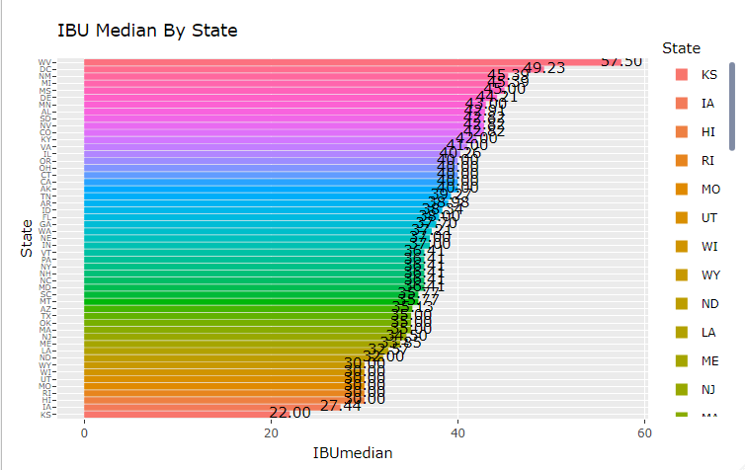
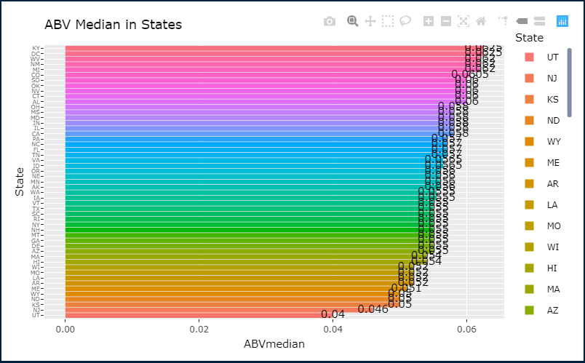
EDA - Median Analysis by State
The median IBU per state appears to change considerably between states with an overall IBU median of 37. West Virginia has the highest IBU at 57.5 and Kansas has the lowest at 22
(Fig. 2)
The median ABV per state appears fairly consistent with an overall ABV median of 0.056. Kentucky has the highest ABV at 0.062 and Utah has the lowest at 0.04
(Fig. 1)
Figure 2 IBU Median By State
Figure 1 ABV Median By State
Notes:
Questions 4 and 5

Slide 7
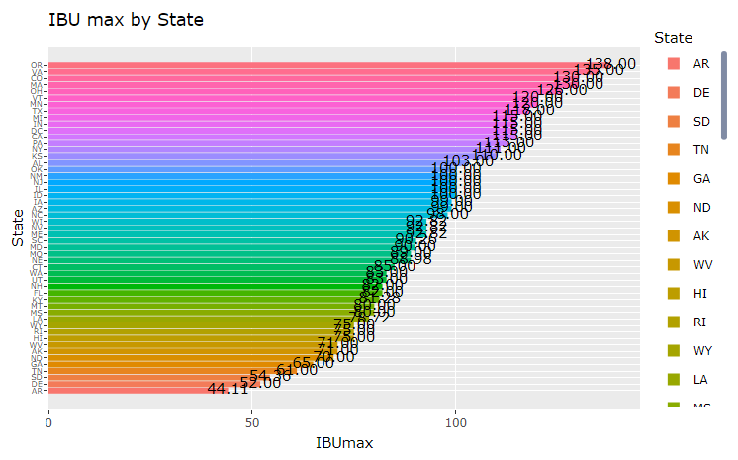
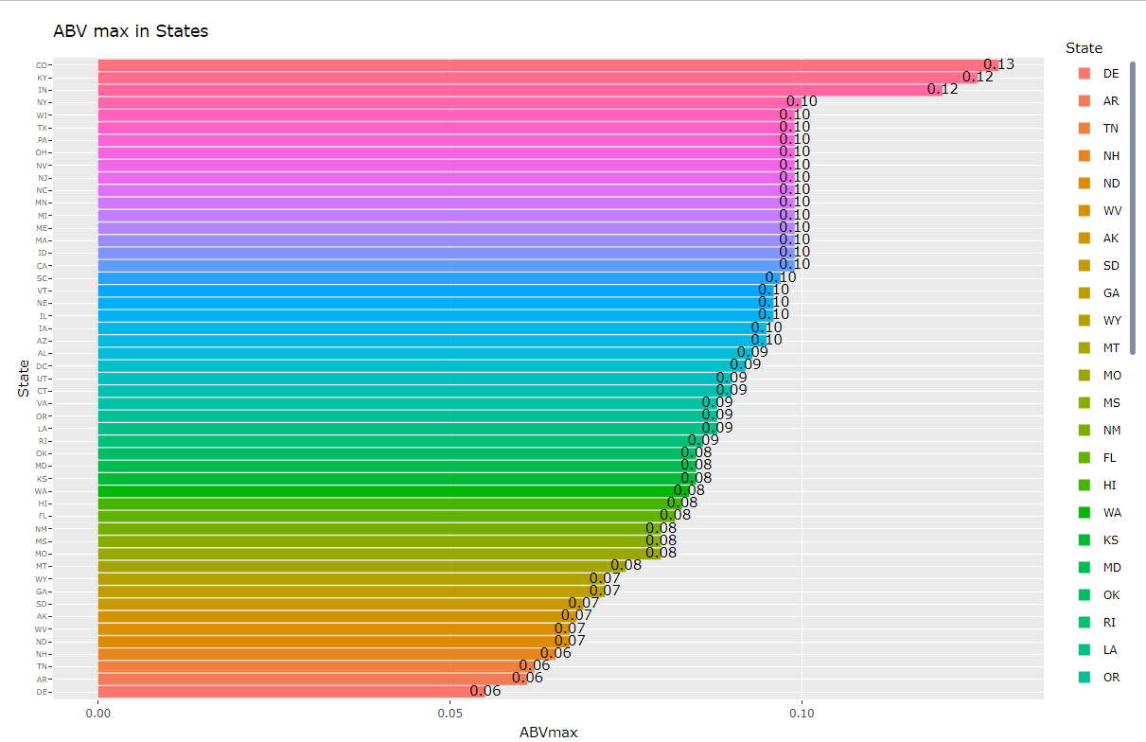
EDA – Statistical Analysis by State Maximum ABV and IBU
The maximum IBU per state appears to vary between states with an overall median of all max values at 92.82. Oregon has the highest Max IBU at 138 and Arkansas has the lowest at 44.11 (Fig. 2)
The maximum ABV per state appears to vary between states with an overall median of all max values at 0.09. Colorado has the highest Max ABV at 0.128 and Delaware has the lowest at 0.055 (Fig. 1)
Figure 2 IBU Max By State
Figure 1 ABV Max By State
Notes:
Questions 4 and 5

Slide 8
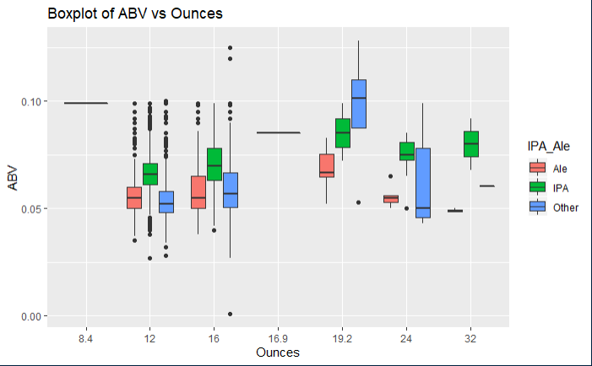
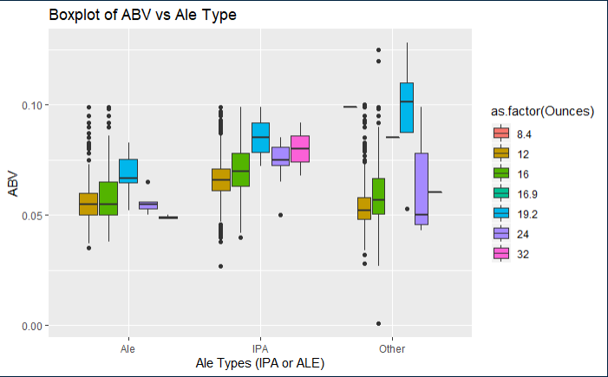
STATISTICS and DISTRIBUTION OF ABV
The ABV per size of can (oz) clearly illustrates that the IPA variety has more Alcohol By Volume than other varieties. This across all can sizes with one exception (can size=19.2). (Fig. 2)
The ABV clearly illustrates that the IPA variety has more Alcohol By Volume than other varieties. This is across all can sizes with one exception (can size=19.2) in the “other” type. (Fig. 1)
Figure 2 ABV by Size of can in Ounces
Figure 1 ABV by Ale Type
Notes:
Ask professor about the other category during ls. # 8 IPA

Slide 9
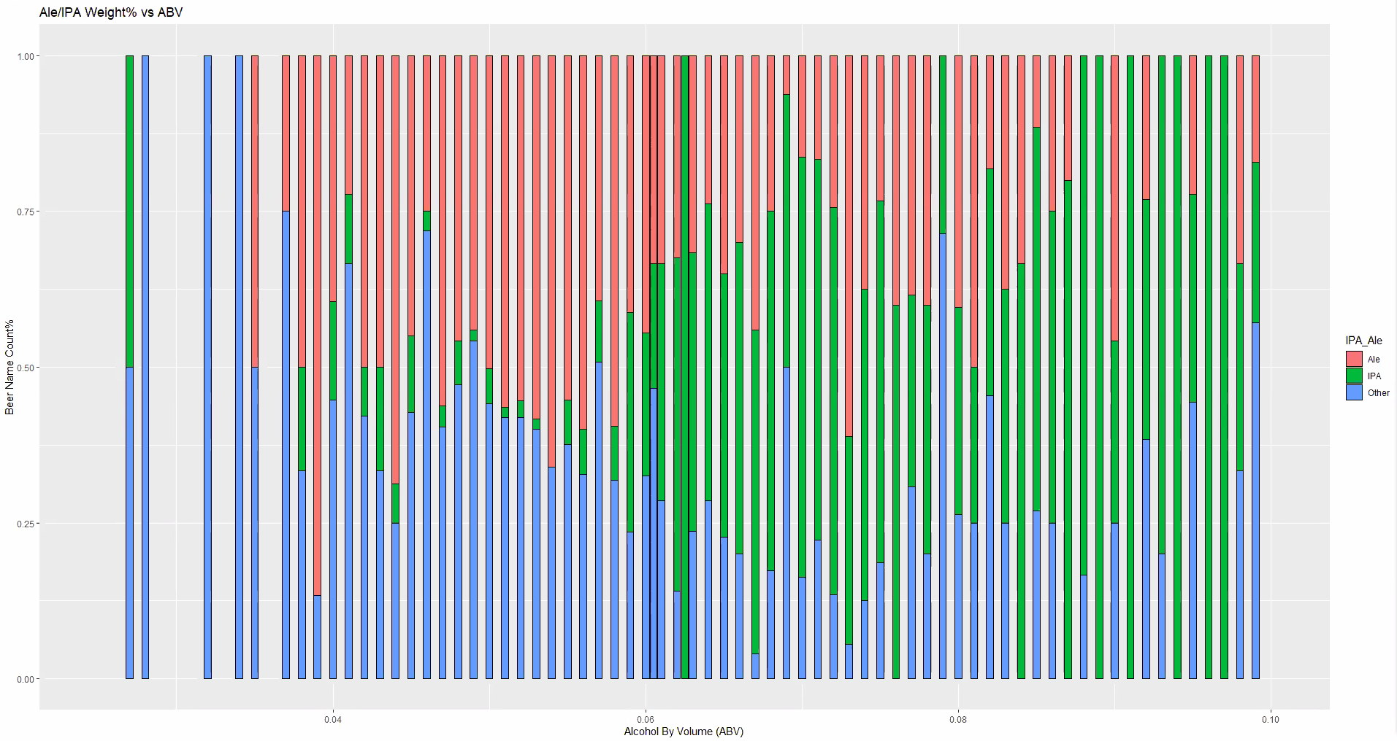
STATISTICS and DISTRIBUTION OF ABV
IPA style beer is the predominant variety when ABV exceeds 0.06. This again indicates that IPA beer tends to have higher alcohol content than other variety.

Slide 10
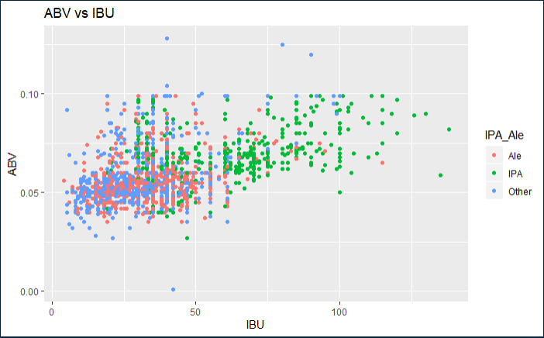
STATISTICS and DISTRIBUTION OF ABV & IBU
The point plot below illustrates what appears to a positive linear relationship between the ABB and IBU.

Slide 11
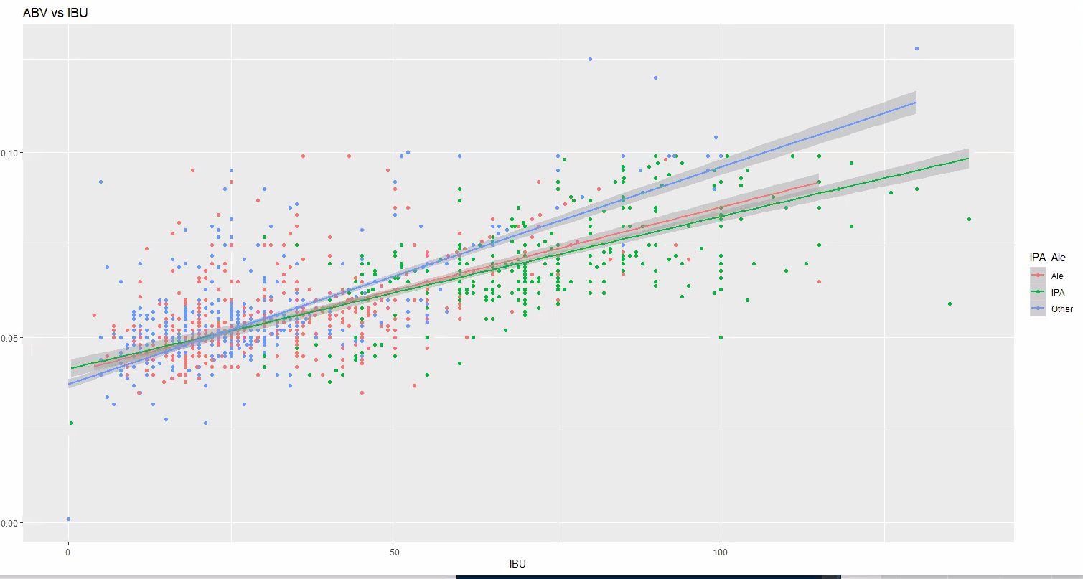
RELATIONSHIP ABV v. IBU
The addition of line trend to the point plot below confirms the presence of a positive linear relationship between the ABV and IBU.

Slide 12
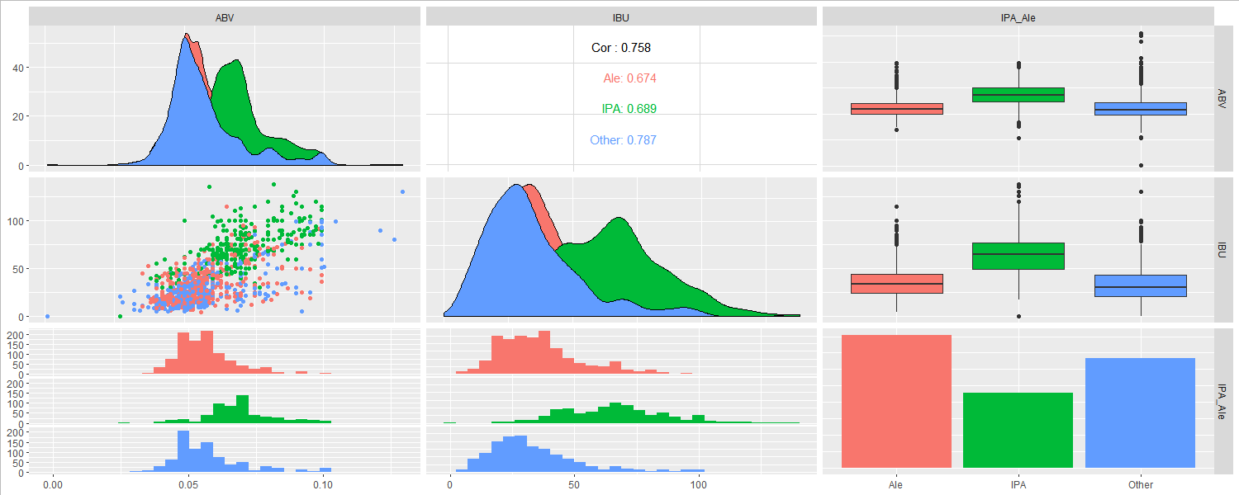
RELATIONSHIP ABV v. IBU
GGPairs Plot below shows a strong correlation between ABV and IBU across all styles of beers. The strongest correlation is in other beer style category at 0.787 followed by IPA at 0.689.

Slide 13
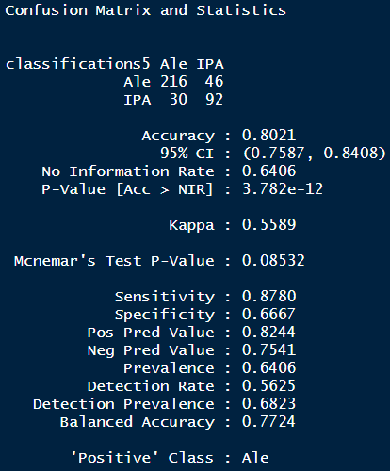
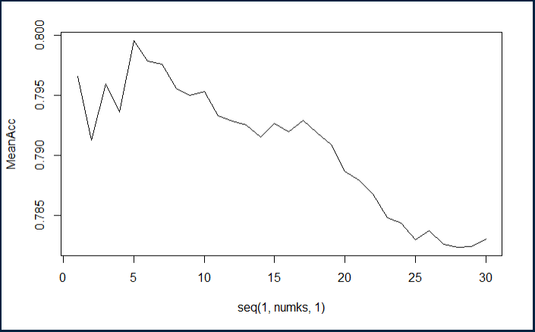
KNN CLUSTERING for IPAs vs Ale
A KNN classification model with a 75% split and 50 iteration results in an 80% (Fig. 1) classification accuracy as shown in the confusion matrix in (Fig. 1). This was achieve by trying 30 different K values resulting in K=5 as the optimal value as shown (Fig. 2).
Split % = 75%
Iterations = 50
Num of ks = 30
Optimal K = 5
Figure 1 Confusion Matrix
Figure 2 Optimal K value based on 75% training split

Slide 14
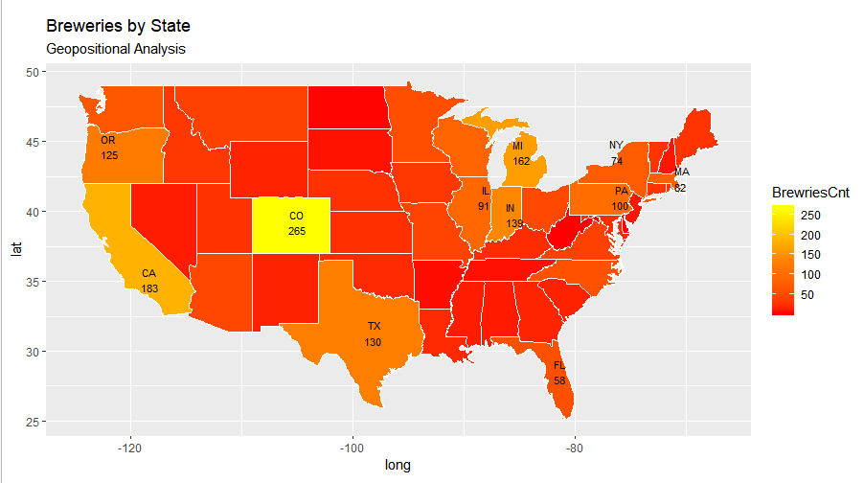
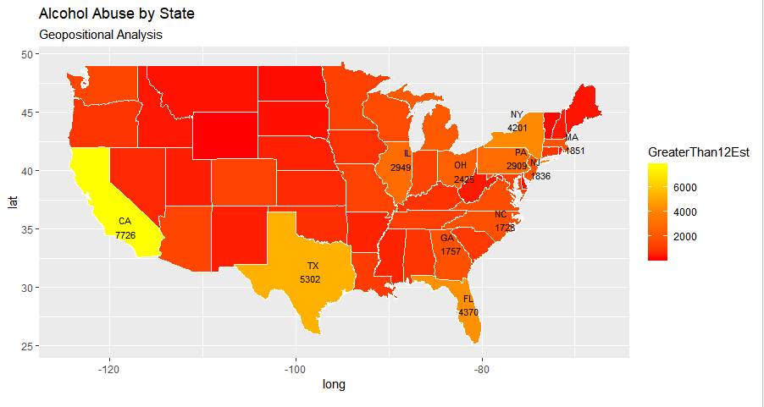
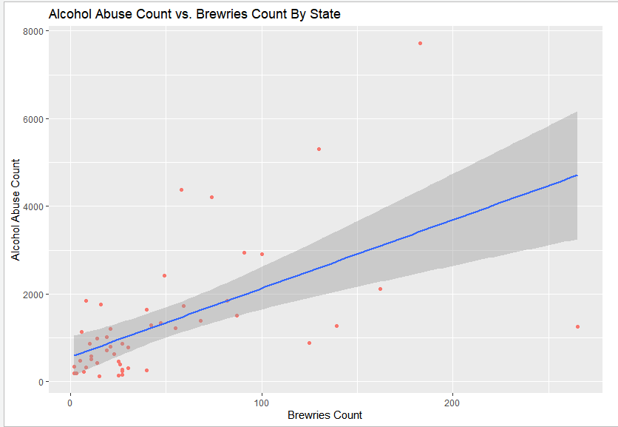
Additional Analysis
Based on visual Geo-positional analysis of Breweries presence by state (count) and Alcohol abuse by State (source: US Dept. of Health & Human Services) there appears to be a correlation.
Figure 1 Breweries Geo-positional Map
Figure 2 Alcohol Abuse by State Geo-positional Map
The correlation analysis reveals the presence of positive linear relationship between the alcohol abuse and the count of the breweries. Based on this, Budweiser may want to establish an out reach program to educate people about the dangers of alcohol abuse especially in state where Budweiser had significant presence.
Figure 2 Alcohol Abuse by State Geo-positional Map
https://www.samhsa.gov/data/report/2018-national-directory-drug-and-alcohol-abuse-treatment-facilities

